Slide 1
CSS

Slide 2
What is CSS ?
CSS stands for “Cascading Style Sheets”
Cascading: refers to the procedure that determines which style will apply to a certain section, if you have more than one style rule.
Style: how you want a certain part of your page to look. You can set things like color, margins, font, etc for things like tables, paragraphs, and headings.
Sheets: the “sheets” are like templates, or a set of rules, for determining how the webpage will look.
CSS is a stylesheet language used to describe the presentation of a document written in HTML or XML.

Slide 3
CSS
History
CSS1 was the first edition introduced in 1996.
CSS2 was published in 1998 and provides enhancement over CSS1.
CSS2.1 was the last 2nd generation edition of CSS.
CSS 3 is the latest edition. Several new functionalities have been provided through CSS3.
Functions like rounded corners, backgroubnd decoration, box shadows, which are demonstrated in the subsequesnt sections, are introduced in this version.

Slide 4
CSS
Advantages
A web application will contains hundreds of web pages, which are created using HTML.
Formatting these HTML pages will be a laborious process, as formatting elements need to be applied to each and every page.
CSS saves lots of work as we can change the appearance and layout of all the web pages by editing just one single CSS file.

Slide 5
CSS Syntax Rules
Rule have two parts - Selector and declaration.
Selector: The HTML element you want to add style to.
<p> <h1> <table> etc
Declaration: The statement of style for that element. Made up of property and value.
Rules
Declaration
Selector
p {font-family:Arial;}
Property
Value
Declaration
Notes:
A CSS declaration must always end with semi colon.
There can be multiple declarations represented by multiple property value pairs.
You can also have declarations on separate lines for easy readability like –
P {
font-family:Arial; }
4. CSS is a Case-Senstive.

Slide 6
CSS Style Example
Selector - I want the text color of my paragraph to be red and the background color to be black.
<html>
<head>
<style> p {font-family:Arial; color: red; background-color:black;} </style>
</head>
<body>
<p> <b> Welcome to Snapdeal Academy </b> </p>
</body>
</html>
Welcome to Snapdeal Academy

Slide 7
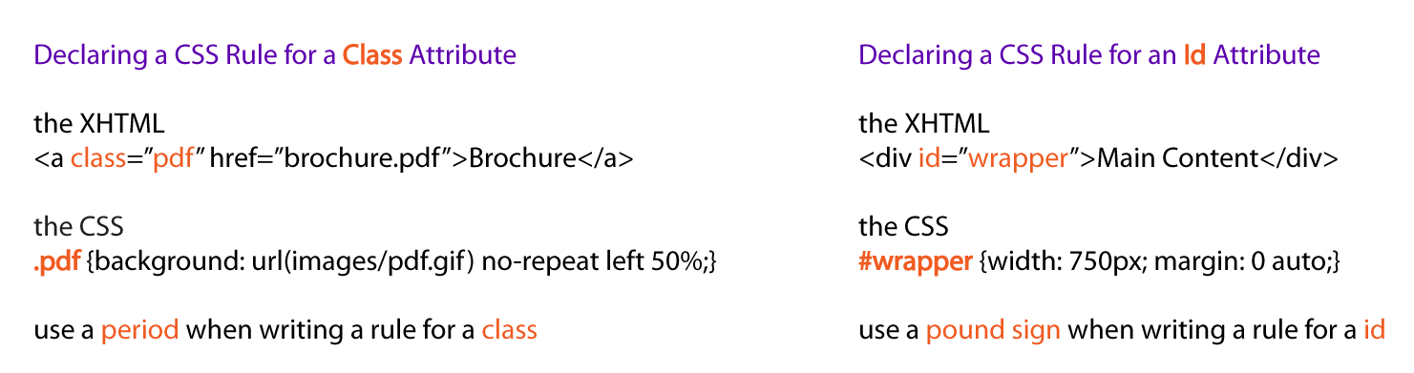
CSS Selectors
CSS selectors allow you to select and manipulate HTML elements based on their id, class, type, attribute, and more.
Examples –

Slide 8
CSS Selectors (Cont.)
Declaring a CSS Rule for a Elements Attribute
It will style all the content of that element which you are selecting.
Example-
The HTML
<p> Welcome to the Sujata Academy </p>
<p> <b><i> Powered by – Sujata Batra </i></b></p>
The CSS
p {text-align: center; color: blue;}

Slide 9
CSS Selectors (Cont.)
Grouping Selectors
You can group all the selectors of same style to minimize the code. The selectors should be separated with comma.
Example-
h2 {text-align: center; color: red; } p {text-align: center; color: red;}
Grouped Selectors-
h2, p {text-align: center; color: red; }

Slide 10
Inserting a StyleSheet
You can do in three different ways-
External Style Sheet
Styles are specified in an external CSS file. you can change the looks of entire website by using single external style sheet.
Eg.: <head> <link rel="stylesheet" type="text/css" href=“ex1.css” /> </head>
Internal Style Sheet
To Appy specific styles to a single HTML file inside the head section of an HTML page.
Eg.: <style> p { text-align:left; font-size:24px; } </style>
Inline Styles
Styles are specified inside an HTML tag/element.
Eg.: <p style="font-family:Algerian; font-size:28px;"> Demo of Inline Style </p>

Slide 11
Inserting a StyleSheet
Multiple Style Sheets – It can be referenced inside an HTML document.
The questions is, what styles will be applicable when there is more than one style specified?
All styles cascade into a new virtual style sheet by applying the following rules, where the higher number has the greater priority:
Browser default.
External Stylesheet.
Internal Stylesheet (styles defined in head section).
Inline Style (styles defined in an HTML element).
Notes:
As you can observe, Inline Style has the highest priority. This means that the inline style defined in an HTML element will override a style defined within the head section, which in turn may override the style defined within an external style sheet.
If the link to the external style sheet is placed below the internal style sheet in HTML <head>, the external style sheet will override the internal style sheet!

Slide 12
Formatting with CSS Properties
CSS Background
We can use CSS Background properties to define the background effects of an element.
The following properties can be used for background effects :
background-color
The background-color property is used to specify the background color of the element.
background-image
The background-image property is used to set an image as a background of an element.
background-repeat
background-attachment
used to specify if the background image is fixed or scroll with the rest of the page in browser window.
background-position
used to define the initial position of the background image.
By default, the background image is placed on the top-left of the webpage.

Slide 13
Formatting with CSS Properties
CSS Background Image
You can use an image as the background for an element using background-image property.
Example-
body{ background-image:url(‘java.png’); }
By default, the image is repeated, both horizontally and vertically, so as to cover the entire
body (or the element on which it is applied).

Slide 14
Formatting with CSS Properties
CSS Background Color
The background-color property is used to specify the background color of an element.
Example-
body {
background-color:darkblue;
}
Similarly, we can specify the background for any element (wherever applicable).
p { background-color:orange; }

Slide 15
Formatting with CSS Properties
CSS Background Position
If the background image disturbs the text, i.e. if the text cannot be read clearly due to
the image in the background, we can set the position of the background image.
Example-
body {
background-image:url(“SomeImage.jpg");
background-repeat:no-repeat;
background-position:right top;
}

Slide 16
Formatting with CSS Properties
CSS Background Shorthand
You can also specify all the properties in a single property. This property is known as shorthand property.
For specifying shorthand property, you just need to use background.
Example-
body {
background:cyan url(‘SomeImage.jpg') no-repeat right top;
}

Slide 17
Formatting with CSS Properties
Text Formatting
The following properties can be used for formatting text :
Text Color
Text Alignment
Text Decoration
Text Transformation
Text Indentation

Slide 18
Formatting with CSS Properties
Text Alignment
We can either align the text to the left, right, center or we can make it justified.
Example-
p { text-align:left;}
h1{text-align:center;}
Text Color
The color property is used to set the color of text.
Example-
body { color:blue;}
p1 {color:magenta;}

Slide 19
Formatting with CSS Properties
Text Decoration
You can use text-decoration property to set or remove decorations from text.
Example-
p {text-decoration:overline;}
p {text-decoration:line-through;}
p {text-decoration:underline;}
Text Transformation
You can use text-transform property to specify uppercase and lowercase letters of any text.
Example-
h1 {text-transform:uppercase;}
h2 {text-transform:lowercase;}
p {text-transform:capitalize;}

Slide 20
Formatting with CSS Properties
CSS Font
CSS font properties are used to define the font family, size, style and boldness of the text. In CSS, there are two types of font family names:
generic family - a group of font families with a similar look (like "Serif" or "Monospace").
font family - a specific font family (like "Times New Roman" or "Arial").
Comments in CSS
/* comment */ - This is comment used in CSS.

Slide 21
Formatting with CSS Properties
CSS Font Family
The font-family property should hold several font names as a "fallback" system. If the browser does not support the first font, it tries the next font.
Example :
p { font-family:”Arial”, Times, “Sans-serif”;}
CSS Font Style
You can use the property font-style to specify mostly italic text. It has three values – Normal, Italic, Oblique (similar to italic).

Slide 22
Formatting with CSS Properties
CSS Font Size
You can use the font-size property to set the size of text. The font-size value can be
absolute or it can be relative.
Example- h1 {
font-size: 30px;
}
p {
font-size: 14px;
}

Slide 23
Formatting with CSS Properties
CSS Font Size with em (Relative Size)
You may face resizing problems, when you use older versions of browsers.
To avoid such problems, you can use set font size using em, instead of pixels.
The em size unit is a W3C recommendation.1 em is equal to the current font size. The default text size is 16 px. So, the default size of 1 em is 16 px.
Example
h2 {
font-size: 1.875em; /* 30px/16=1.875em */
}
p {
font-size: 0.875em; /* 14px/16=0.875em */
}

Slide 24
CSS Units
CSS has several different units for expressing a length.
Many CSS properties take "length" values, such as width, margin, padding, font-size, border-width, etc.
Length is a number followed by a length unit, such as 10px, 2em, etc.
A whitespace cannot appear between the number and the unit. However, if the value is 0, the unit can be omitted.
There are two types of length units:
absolute
relative.

Slide 25
Absolute Lengths
The absolute length units are fixed and a length expressed in any of these will appear as exactly that size.
Pixels (px) are relative to the viewing device. For low-dpi devices, 1px is one device pixel (dot) of the display. For printers and high resolution screens 1px implies multiple device pixels.
Unit | Description
cm | centimeters
mm | millimeters
in | inches (1in = 96px = 2.54cm)
px * | pixels (1px = 1/96th of 1in)
pt | points (1pt = 1/72 of 1in)
pc | picas (1pc = 12 pt)

Slide 26
Relative Lengths
Relative length units specify a length relative to another length property. Relative length units scales better between different rendering mediums.
Viewport = the browser window size. If the viewport is 50cm wide, 1vw = 0.5cm.
Unit | Description
em | Relative to the font-size of the element (2em means 2 times the size of the current font)
ex | Relative to the x-height of the current font (rarely used)
ch | Relative to width of the "0" (zero)
rem | Relative to font-size of the root element
vw | Relative to 1% of the width of the viewport*
vh | Relative to 1% of the height of the viewport*
vmin | Relative to 1% of viewport's* smaller dimension
vmax | Relative to 1% of viewport's* larger dimension
% | Relative to the parent element

Slide 27
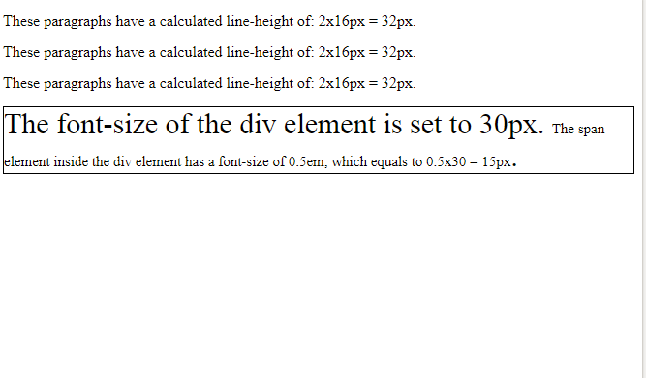
Example
<!DOCTYPE html>
<html>
<head>
<style>
p {
font-size: 16px;
line-height: 1em;
}
div {
font-size: 30px;
border: 1px solid black;
}
span {
font-size: 0.5em;
}
</style>
</head>
<body>
<p>These paragraphs have a calculated line-height of: 2x16px = 32px.</p>
<p>These paragraphs have a calculated line-height of: 2x16px = 32px.</p>
<p>These paragraphs have a calculated line-height of: 2x16px = 32px.</p>
<div>The font-size of the div element is set to 30px. <span>The span element inside the div element has a font-size of 0.5em, which equals to 0.5x30 = 15px</span>.</div>

Slide 28
Formatting with CSS Properties
CSS Links
You can use CSS styles to style any link. Links can be styled in different ways by using any CSS property like color, font-family etc.
Links can be in one of the following states :
a: link – Unvisited link
a: visited – A link that the user has visited
a: hover – A link over which the mouse pointer is moving
a: active – A link, which has been just clicked
Links can be styled according to their states.

Slide 29
Formatting with CSS Properties
Styling Links
CSS Links
a {
font-weight: bold;
}
a:link {
color: black;
}
a:visited {
color: gray;
}
a:hover {
text-decoration: none;
color: white;
background-color: navy;
}
a:active {
color: aqua;
background-color: navy;
}
link - before a visit
visited - after it has been visited
hover - when your mouse is over it but you have not clicked
active - you have clicked it and you have not yet seen the new page

Slide 30
Formatting with CSS Properties
CSS List
You can use CSS list properties for
Setting different list item markers for ordered lists
Setting different list item markers for unordered lists
Set an image as the list item marker
Values-
list-style-type
list-style-image

Slide 31
Formatting with CSS Properties
Box Model : Introduction
Box model is useful for designing the layout of an HTML Page. CSS Box model describes a box that wraps around HTML elements.
Using this model, we can define the margins, borders, padding and the actual content. We can place border around elements and space elements in relation to each other.
Margin
Border
Padding
Box Model : Illustration
You can set the height and width of an element using the height and width properties.
Content

Slide 32
Formatting with CSS Properties
CSS Padding
You can use the CSS padding properties to define the space between the element border and the element content. It is possible to change the top, right, bottom and left padding independently using separate properties.
In shorthand; specify one, two, three, or four space-separated values:
[value] [top, right, bottom, and left] 10px
[value] [value] [top and bottom] [left and right] 10px 20px
[value] [value] [value] [top] [right and left] [bottom] 10px 20px 30px
[value] [value] [value] [value] [top] [right] [bottom] [left] 10px 20px 30px 40px
Note: padding: 10px 20px 30px 40px; is same as padding-top: 10px; padding-right: 20px; padding-bottom: 30px; padding-left: 40px;

Slide 33
Formatting with CSS Properties
CSS Border
You can use the CSS Border properties to specify the style and color of an element’s border.
border-style
To make a border around an element.
Values: solid, dotted, dashed, double, groove, ridge, inset and outset.
border-width
sets the width of the border
There are also properties for border-top-width, border-right-width, border-bottom-width and border-left-width.
border-color
sets the color.

Slide 34
Border-width
In shorthand; specify one, two, three, or four space-separated values:
[value] [top, right, bottom, and left] 10px
[value] [value] [top and bottom] [left and right] 10px 20px
[value] [value] [value] [top] [right and left] [bottom] 10px 20px 30px
[value] [value] [value] [value] [top] [right] [bottom] [left] 10px 20px 30px 40px
Note : border-width: 10px 20px 30px 40px; is same as border-top-width: 10px; border-right-width: 20px; border-bottom-width: 30px; border-left-width: 40px;

Slide 35
Formatting with CSS Properties
CSS Margin
Using CSS Margin properties you can specify the space around elements.
One, two, three, or four space-separated values:
[value] [top, right, bottom, and left] 10px
[value] [value] [top and bottom] [left and right] 10px 20px
[value] [value] [value] [top] [right and left] [bottom] 10px 20px 30px
[value] [value] [value] [value] [top] [right] [bottom] [left] 10px 20px 30px 40px
Note : margin: 10px 20px 30px 40px; is same as margin-top: 10px; margin-right: 20px; margin-bottom: 30px; margin-left: 40px;, for example.

Slide 36
Formatting with CSS Properties
Pseudo-Class
A pseudo-class is used to define a special state of an element.
Style an element when a user mouses over it.
Style visited and unvisited links differently.
/* unvisited link */ a:link { color: #FF0000; } /* visited link */ a:visited { color: #00FF00; } /* mouse over link */ a:hover { color: #FF00FF; } /* selected link */ a:active { color: #0000FF; }

Slide 37
Formatting with CSS Properties
Pseudo-Elements
A CSS pseudo-element is used to style specified parts of an element.
Style the first letter, or line, of an element
Insert content before, or after, the content of an element
The ::first-line pseudo-element is used to add a special style to the first line of a text. All Pseudo Elements-
Selector | Example | Example description
::after | p::after | Insert content after every <p> element
::before | p::before | Insert content before every <p> element
::first-letter | p::first-letter | Selects the first letter of every <p> element
::first-line | p::first-line | Selects the first line of every <p> element
::selection | p::selection | Selects the portion of an element that is selected by a user
Notes:
Note: ::selection always starts with double colons (::).

Slide 38
Formatting with CSS Properties
Media Types
The @media rule makes it possible to define different style rules for different media types in the same stylesheet.
Example-
@media screen {
p { font-family: verdana, sans-serif;
font-size: 20px;
} }
@media print {
p { font-family: georgia, serif;
font-size: 15px;
color: blue;
} }
Notes:
Note: ::selection always starts with double colons (::).

Slide 39
CSS float
The CSS float property is a positioning property.
Used to push an element to the left or right, allowing other element to wrap around it.
Generally used with images and layouts.

Slide 40
How it works
A floated element may be moved as far to the left or the right as possible. Simply, it means that a floated element can display at extreme left or extreme right.
The elements after the floating element will flow around it.
The elements before the floating element will not be affected.
If the image floated to the right, the texts flow around it, to the left and if the image floated to the left, the text flows around it, to the right.

Slide 41
CSS float Properties
Property | Description | Values
clear | The clear property is used to avoid elements after the floating elements which flow around it. | left, right, both, none, inherit
float | It specifies whether the box should float or not. | left, right, none, inherit

Slide 42
CSS Float Property Values
Value | Description
none | It specifies that the element is not floated, and will be displayed just where it occurs in the text. this is a default value.
left | It is used to float the element to the left.
right | It is used to float the element to the right.
initial | It sets the property to its initial value.
inherit | It is used to inherit this property from its parent element.

Slide 43
Final Example
<!DOCTYPE html>
<html>
<head>
<style>
.header{margin:-8px -8px 0px;background-color:red;color:white;text-align:center;padding:10px;}
.container{width:100%}
.left{width:15%px;float:left;}
.body{width:65%;float:left;background-color:pink;padding:5px;}
.right{width:15%;float:left;}
.footer{margin:-8px;clear:both;background-color:green;color:white;text-align:center;padding:10px;}
</style>
</head>

Slide 44
<body>
<div class="header"><h2>Sujata Training</h2></div>
<div class="container">
<div class="left">
<p>Left Page</p>
</div>
<div class="body">
<h1>Body Page</h1>
<p>Page Content goes here</p><p>Page Content goes here</p><p>Page Content goes here</p>
<p>Page Content goes here</p><p>Page Content goes here</p><p>Page Content goes here</p>
<p>Page Content goes here</p><p>Page Content goes here</p><p>Page Content goes here</p>
<p>Page Content goes here</p><p>Page Content goes here</p><p>Page Content goes here</p>
<p>Page Content goes here</p>
</div>
<div class="right">
<p>Right Page</p>
</div>
</div>
<div class="footer">
<p>Footer</p>
</div>
</body>
</html>

Slide 45
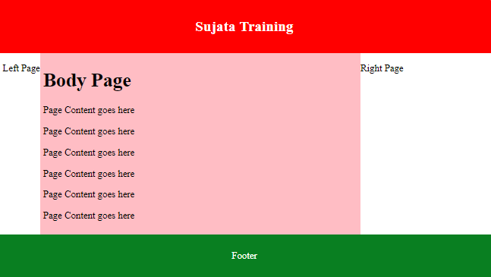

Slide 46
Writing for Web Audience
Punch up headlines.
Web visitors scan first for headlines, so make every heading word meaningful.
Emphasize key concepts.
Help readers scan for key concepts by emphasizing important information.
Harness the power of lists.
Lists slow the reader down and bring attention to important information
Create meaningful captions.
Web users focus on text over graphics, make sure to caption all graphics clearly.
Simplify for understanding.
Reading from the screen is slower than reading from print, so make your users happy by giving them less to read.

Slide 47
Writing for Web Audience
Invert the pyramid.
The inverted pyramid style is bottom-up. To write this way, start by stating the conclusion. Then build upon the conclusion by summarizing the most interesting and important supportive information. Next provide detail about each important point. Then close with background information.
Write one idea per paragraph.
Make sure each paragraph contains one idea only, and summarize that idea in the first sentence.
Make each page stand alone.
Don't expect that users will enter your Web site at the home page and work their way through the site in an organized manner. Thanks to the power of search engines and offsite links, visitors may enter your site on any page at all. Because of this, each page needs to stand alone, and your prose must not assume that they have already read any other page. Provide context to help users understand where the page fits within your Web site.

Slide 48
Writing for Web Audience
Be current, accurate, and credible.
Capture the trust of your readers by offering information that is up-to-date and accurate .
A simple way to improve credibility: Skip the marketing hype. Replace it with well-written, interesting, and useful information.
Give credit where credit is due. If your site has multiple authors, give each one credit with a byline. Bylines are personal touches that add credibility to a Web site. And don't just quote information from a study or survey; you'll gain credibility by providing a direct link to the source.

Slide 49
What are CSS preprocessors?
CSS preprocessors are also referred to as being ‘dynamic style sheet languages’. They have been developed to add a programming functionality to the editing of Cascading Style Sheets. CSS Preprocessors convert code into a true CSS by taking the same written code from a simple preprocessed language (CSS with added extensions). Besides CSS preprocessors are used to add extensions which aren’t used in CSS yet like: functions, mixins, nested rules, variables, operations and inheritance.

Slide 50
Common CSS Preprocessor
There is a surprising number of CSS preprocessing languages available out there.
Few Examples are LESS, SASS, Turbine, Switch CSS, Stylus, CSS Cacheer, CSS Preprocessor, DtCSS, CSS-Crush, Myth, Rework.

Slide 51
Advantages of CSS Preprocessors
Ability to add variables, functions, etc.
Join Multiple Files
CSS Preprocessor Helps You Avoid Repetitions
Nested Syntax
Less Time to Code
Darken & Lighten functionality

Slide 52
Disadvantages of CSS Preprocessors
Debugging is harder
Compilation slows down development
They can produce very large CSS files
Maintainence and overengineering
Tooling and developer convenience

Slide 53
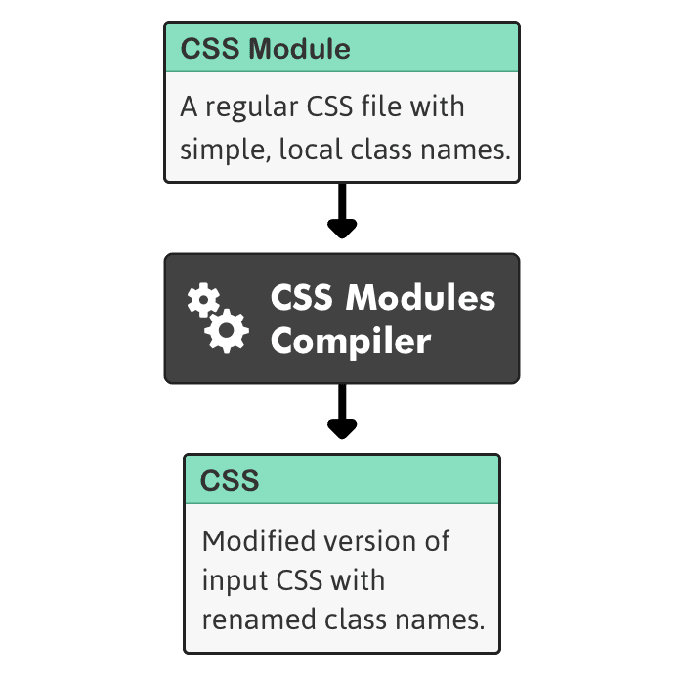
CSS Modules
A CSS Module is a CSS file in which all class names and animation names are scoped locally by default.
'CSS Module' is just a .css file. You call it a 'CSS Module' if you plan on using it with a CSS Modules compiler.

Slide 54
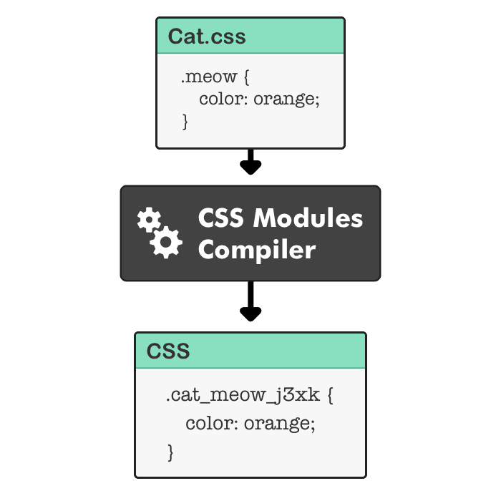
Example

Slide 56
Cascade
The cascade sorts out all conflicts when multiple declarations would affect a given element.
Important declarations will override less important ones.
Among declarations with equal importance, the rule’s specificity controls which one will apply.
And, all else being equal, the source order makes the final distinction.

Slide 57
Cascading
It’s the mechanism that controls the end result when multiple, conflicting CSS declarations apply to the same element.
Its controlled by the order in which CSS declarations are applied:
Importance
Specificity
Source order

Slide 58
Specificity
It can be thought of as a measure of how specific a rule’s selector is.
A selector with low specificity may match many elements (like * which matches every element in the document),
while a selector with high specificity might only match a single element on a page (like #nav that only matches the element with an id of nav).
If two or more declarations conflict for a given element, and all the declarations have the same importance, then the one in the rule with the most specific selector will “win”.

Slide 59
Source order
If two declarations affect the same element, have the same importance and the same specificity, the final distinguishing mark is the source order.
The declaration that appears later in the style sheets will “win” over those that come before it.

Slide 60
Inheritance
Process by which properties are passed from parent to child elements
even though those properties have not been explicitly defined by other means.
Certain properties are inherited automatically
styles that apply to text are inherited,
borders, margins and paddings and similar styles are not.
Inheritance and the Cascade
inheritance applies to the DOM tree
cascade deals with the style sheet rules.

Slide 61
Inheritance
<style>
p {
color: red;
border:2px solid blue;
}
strong{
border:inherit ;
}
</style>
<p>
<strong>This is the First Paragraph</strong>
The second line of this paragraph is also created with the styles.
</p>

Slide 62
!important
Important declarations help override normal specificity when making changes to their stylesheets.
It provides a way for a stylesheet author to give a CSS value more weight than it naturally has.
Its a reference to an entire CSS declaration, including property and value
#example { font-size: 14px !important; }
#container #example { font-size: 10px; }

Slide 63
!important
!important keyword must be placed at the end of the line,
Prefix ! Doesn’t means not.
'this is important, ignore subsequent rules, and any usual specificity issues, apply this rule!'
Defining a rule with the !important discards the normal concerns as regards the 'later' rule overriding the 'earlier' ones.
Should be Used with Caution in the most appropriate Cases

Slide 64
Introduction
Need to Build a website suitable to work on every device and every screen size
Desktop computer and cell phone users alike should get the same benefit
Need to provide an intuitive and gratifying experience for all.

Slide 65
Responsive vs. Adaptive vs. Mobile
Closely related, and often transposed as one in the same.
Responsive
to react quickly and positively to any change,
Changes continually and fluidly based on viewport width
Adaptive
To be easily modified for a new purpose or situation,
Adapt to the width of the browser at a specific points
May show elements, resize text/images, reflow elements as resolution changes
A combination of the two is ideal
Mobile :
Build a separate website commonly on a new domain solely for mobile users.

Slide 66
Responsive Web Design
Flexible and Fluid layout
Uses relative sizing of grids, not fixed
Based on columns that can be reflowed
Allows grid layout to adjust to viewport size
Media queries
Target media types and media features
Tests for max/min width & height on viewport and device, device orientation, aspect radio, resolution
Responsive images
Relative widths (CSS) or dynamic replacement (JS)

Slide 67
Flexible box

Slide 68
Flexible Box
"flexbox"
Alternative to using tables, floats, inline-blocks
Used to layout, align and distribute space among items in a container
even when their size is unknown and/or dynamic
Container has the ability to alter its items' width/height and order to best fill the available space
To accommodate all kind of display devices and screen sizes
Expands items to fill available free space, or shrinks them to prevent overflow.

Slide 69
Flex-Box
Direction-agnostic as opposed to the regular layouts
Block is vertically-based
Inline is horizontally-based
Less flexible for complex applications
Properties for the Parent
Designed by Setting the Display Property to Flex
It enables a flex context for all its direct children.
. container {
display: flex;
}

Slide 70
Flex-Direction
Establishes the main-axis, direction for flex items to be placed in the flex container.
Flex box is a single-direction layout concept.
laying out either in horizontal rows or vertical columns.
row is the default layout
row-reverse: right to left in ltr; left to right in rtl
.container {
flex-direction: row | row-reverse | column | column-reverse;
}

Slide 71
Justify-content
Defines the alignment along the main axis.
Distribute extra free space left over when either all the flex items on a line are inflexible, or are flexible but have reached their maximum size.
Can also control over the alignment of items when they overflow the line.
.container {
justify-content: flex-start | flex-end | center | space-between | space-around;
}

Slide 72
Flex Box –Align Items
To Display flex items along the cross axis on the current line.
Its justify-content along perpendicular to the main-axis.
.container {
align-items: flex-start | flex-end | center | stretch;
}

Slide 73
Child Elements - Order
The Flex Model has some properties for Child Elements
Order
By default, flex items are laid out in the source order.
Order property controls the order in which they appear in the flex container.
.item { order: 2; }

Slide 74
Child Elements – flex-grow
Ability of a flex item to grow if necessary.
To specify the amount of the available space inside the flex container the item should take up.
flex-grow : 1
The space in the container will be distributed equally to all children.
flex-grow : 2
A Children with a value of 2Child Element would take up twice as much space as the others
.item { flex-grow: <number>; /* default 0 */ }

Slide 75
Flex Box
flex-basis
defines the default size of an element before the remaining space is distributed.
Flex-basis : 0
the extra space around content isn't factored in.
Flex-basis :auto
the extra space is distributed based on its flex-grow value
Flex
Shorthand for flex-grow, flex-shrink and flex-basis
flex-shrink and flex-basis are optional.
Default is 0 1 auto.

Slide 76
Flex-Grow
.container{
width: 90%;
display: flex;
border: 2px solid blue; }
.box1{
flex-basis: 0;
flex-grow: 1; }
.box2 {
flex-basis: 0;
flex-grow: 2; }
.box3{
flex-basis: 0;
flex-grow: 3; }

Slide 77
Media Queries

Slide 78
Media Queries
A way of specifying different styles for individual browser and device circumstances, the width of the viewport or device orientation
Common media types include
all, screen, print, tv, and braille.
default the media type to screen.
Some CSS properties are only designed for certain media.
The font-size property can be used for both screen and print media, but possibly with different values.
It is necessary to specify that a style sheet, or a set of style rules, applies to certain media types.

Slide 79
View Port
The viewport is the user's visible area of a web page.
It varies with the device
Smaller on a mobile phone than on a computer screen.
Set in the Head Section of the HTML Page
<meta name="viewport" content="">
Content
Can enter a set comma delimited values
For mobile design can specify the viewport width:
Width
The width property controls the size of the viewport.
<meta name="viewport" content="width=320">

Slide 80
View Port
<meta name="viewport" content="width=device-width">
For flexible layouts viewport width is based on the device
<meta name="viewport" content="initial-scale=1">
To make sure layout will be displayed as intended its set with a zoom level.
It will ensure that upon opening layout will be displayed properly at 1:1 scale.
No zooming will be applied.

Slide 81
View Port
<meta name="viewport" content="maximum-scale=1">
Prevent any zooming by the user:
Used If there is a genuine need for preventing zooming
<meta name="viewport" content="width=device-width, initial-scale=1“>
Can combine the values together which can act as default
Initial-Scale to 1
initial page zoom level , on the page load
Can disable zoom completely with use scale= false
Zoom Works with Mobile and Not in Browsers

Slide 82
@View Port
At-rules are special instructions for the CSS parser.
They are invoked by an at-keyword preceded by an "@" sign.
Specifies the size, zoom factor, and orientation of the viewport.
@viewport{
zoom: 1.0;
width: device-width;
}
@viewport{
zoom: 1.0;
width: extend-to-zoom;
}

Slide 83
Using the @media At-rules
To define different style rules for different media types in a single style sheet.
A comma-separated list of media types and the CSS declarations block containing the styles rules for target media.
@media screen{
body {
color: #32cd32;
font-family: Arial, sans-serif;
font-size: 14px;
}
}

Slide 84
Using the @media At-rules
@media print {
body {
color: #ff6347;
font-family: Times, serif;
font-size: 12pt;
}
}
@media screen, print {
body {
line-height: 1.2;
}
}

Slide 85
Using the @import At-rules
Instructs the browser to load an external style sheet and use its styles only for print media.
Must occur at the beginning of a style sheet
Any style rule specified in the style sheet itself override the conflicting style rules in the imported style sheets.
@import url("css/screen.css") screen;
@import url("css/print.css") print;
body {
background: #f5f5f5;
line-height: 1.2;
}

